Slide 1


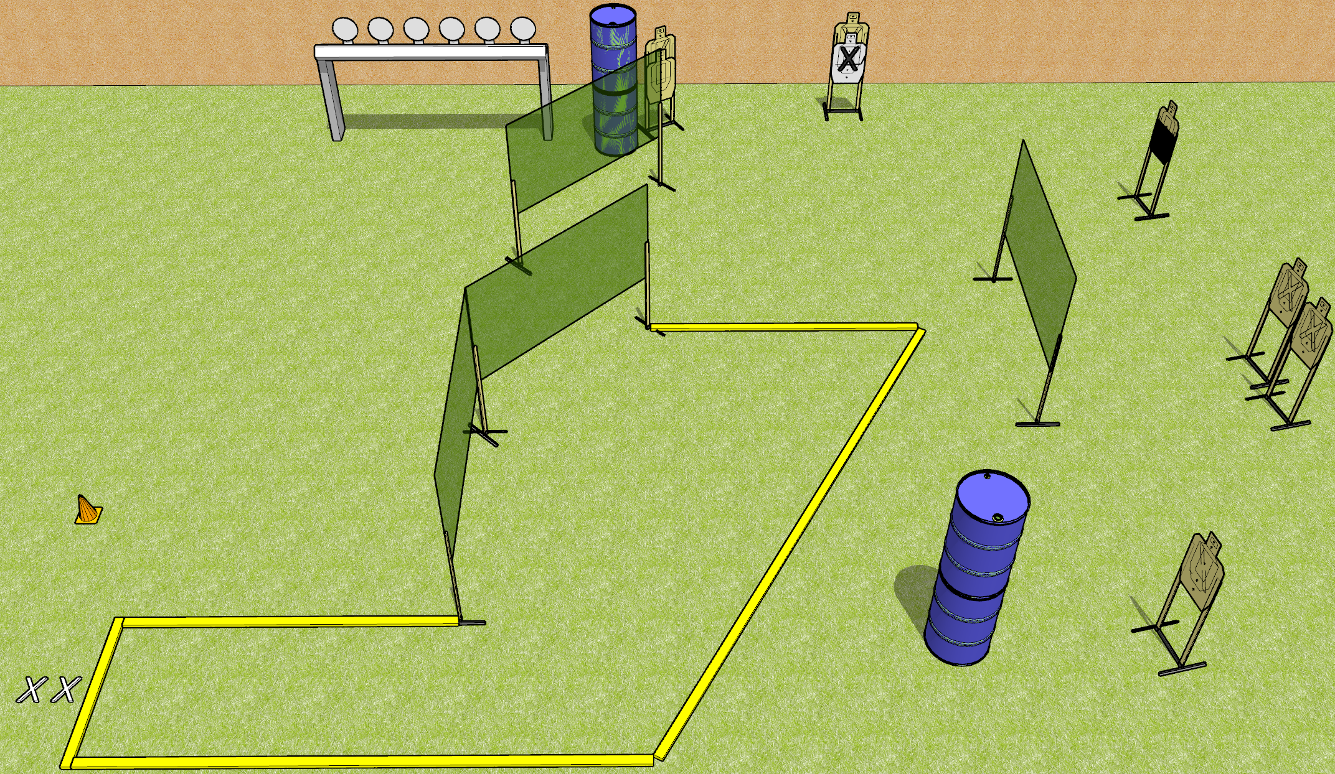
 | Dothan Gun Club – USPSA Match Get that Plate Rack Course Designer : Drew Coleman
START POSITION : Standing with both feet on X’s, wrists below belt
GUN READY CONDITION : Pistol loaded and holstered. PCC loaded, held with both hands, shouldered, safety on, pointed at orange cone. |  | SCORING: Comstock, 20 rounds TARGETS: 7 paper, 6 Steel SCORED HITS: Best 2 on paper, steel until down START-STOP: Audible, last shot RULES:
STAGE PROCEDURE: Engage targets as they become available from within the fault lines.

Slide 2
Get that Plate Rack
Written Stage Briefing
Get that Plate Rack is a 20 round, 100 point, Comstock medium course. There are seven USPSA targets and six falling plates. The best two hits on paper will score, and steel must fall to score. The start signal is audible.
Handgun start position is standing with both feet on X’s, wrists below belt. Pistol is loaded and holstered.
PCC start position is standing with both feet on X’s, muzzle pointed at orange cone. Loaded carbine is held with both hands, shouldered, safety on.
On start signal, engage targets as they become available from within the shooting area.

Slide 3
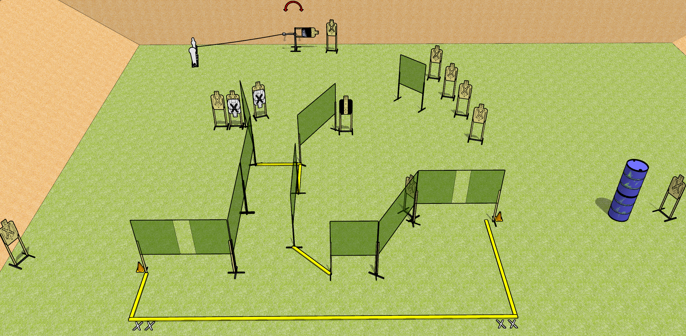
 | Dothan Gun Club – USPSA Match Getting Around Course Designer : Drew Coleman
START POSITION : Standing with both feet on either set of X’s, wrists below belt
GUN READY CONDITION : Pistol loaded and holstered. PCC loaded, held with both hands, shouldered, safety on, pointed at orange cone. |  | SCORING: Comstock, 28 rounds TARGETS: 13 paper, 2 Steel SCORED HITS: Best 2 on paper, steel until down START-STOP: Audible, last shot RULES:
STAGE PROCEDURE: Engage targets as they become available from within the fault lines.

Slide 4
Getting Around
Written Stage Briefing
Getting Around is a 28 round, 140 point, Comstock field course. There are thirteen USPSA targets, one colt popper, and one mini popper. The best two hits on paper will score and steel must fall to score. The start signal is audible.
The mini popper will activate the swinger. Please check to see how the activator is set before walkthrough and set it the same way every time.
Handgun start position is standing with both feet on either set of X’s, wrists below belt. Handgun is loaded and holstered.
PCC start position is standing with both feet on either set of X’s, muzzle pointed at either orange cone. Loaded carbine is held with both hands, shouldered, safety on.
On start signal, engage targets as they become available from within the shooting area.

